Slide 1

RTO Face Scan
Advanced AI Driver Identification System
Regional Transport Office & Traffic Police Initiative
Presented by: GOVIND CHAUDHARI

Slide 2

Executive Summary
RTO Face Scan is an AI-powered system designed to revolutionize traffic enforcement in India.
Instant Identification
Digital E-Challans
Smart Analytics
Real-time face recognition (< 2s).
Paperless, instant fine generation.
Data-driven traffic management.
Multi-Language
Secure
English, Hindi, Gujarati.
Localized data processing and privacy focus.

Slide 3

The Challenge
Current Issues
Operational Gaps
Manual Verification is slow
Lack of real-time data
Physical license checks cause jams
No centralized history
Paper challans are easily lost
High manpower requirement
Hard to track repeat offenders
Inefficient fine collection

Slide 4

The Solution: RTO Face Scan
Deep Learning Core
Seamless Workflow
Uses face-api.js and TensorFlow to map 128 facial landmarks for precise identification.
Scan Face → Fetch Details → Select Violation → Print/SMS Challan.
Field Ready
Insight Driven
Works on laptops, tablets, and kiosks. Online & Offline modes.
Visual dashboards for officer performance and violation trends.

Slide 5

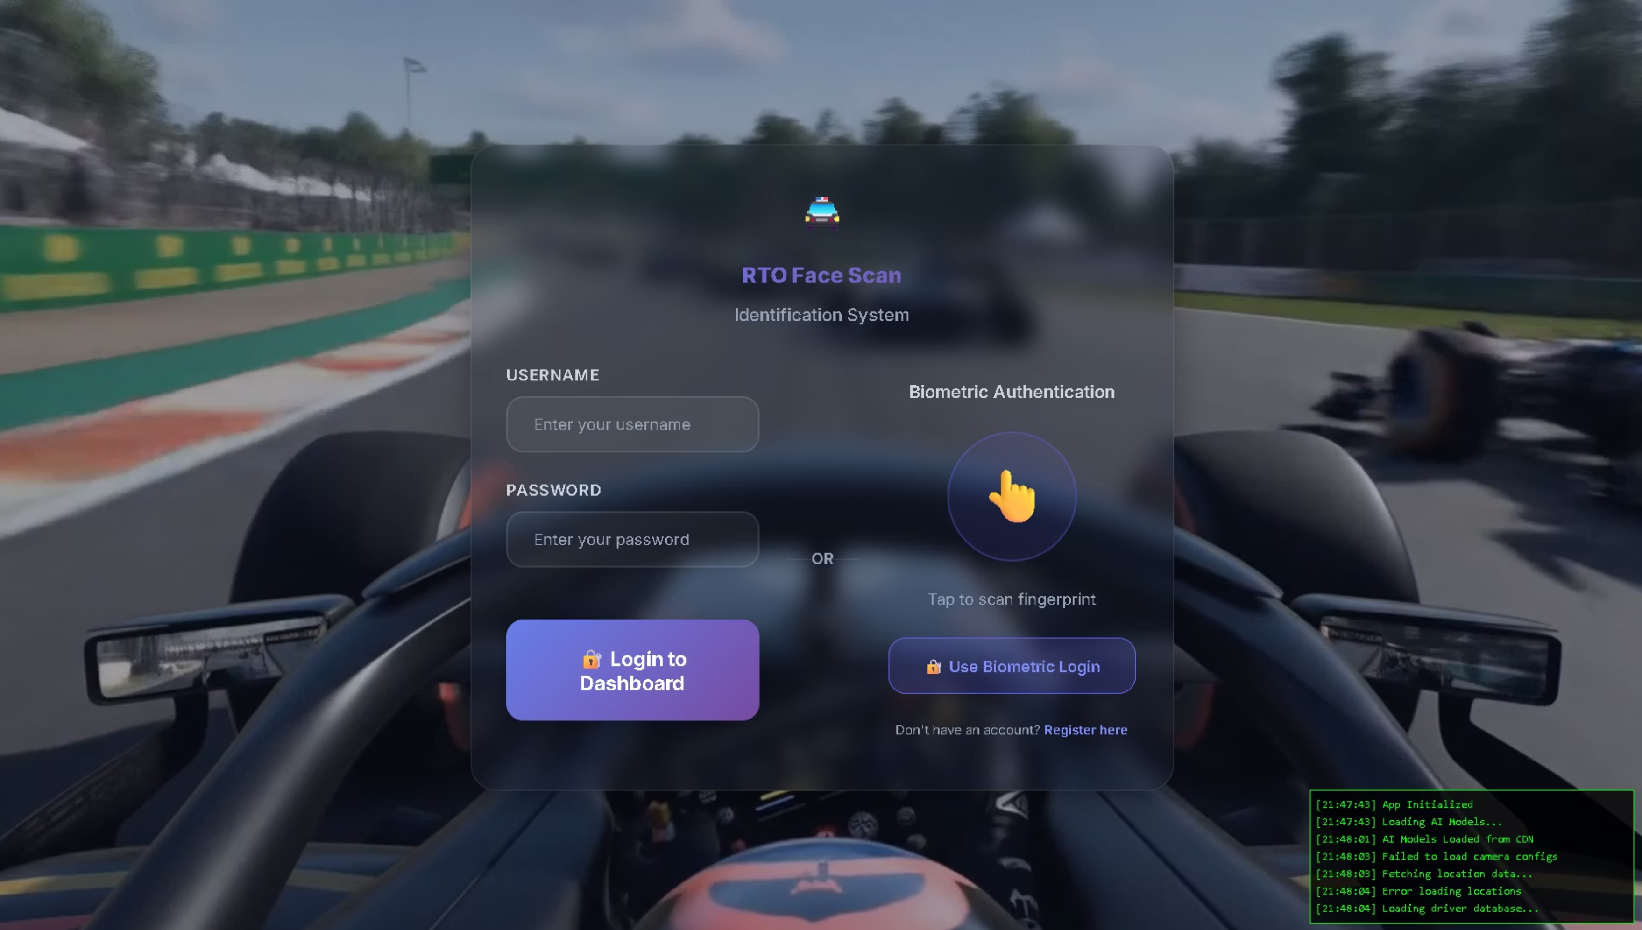
Application Interface
Login Page

Slide 6

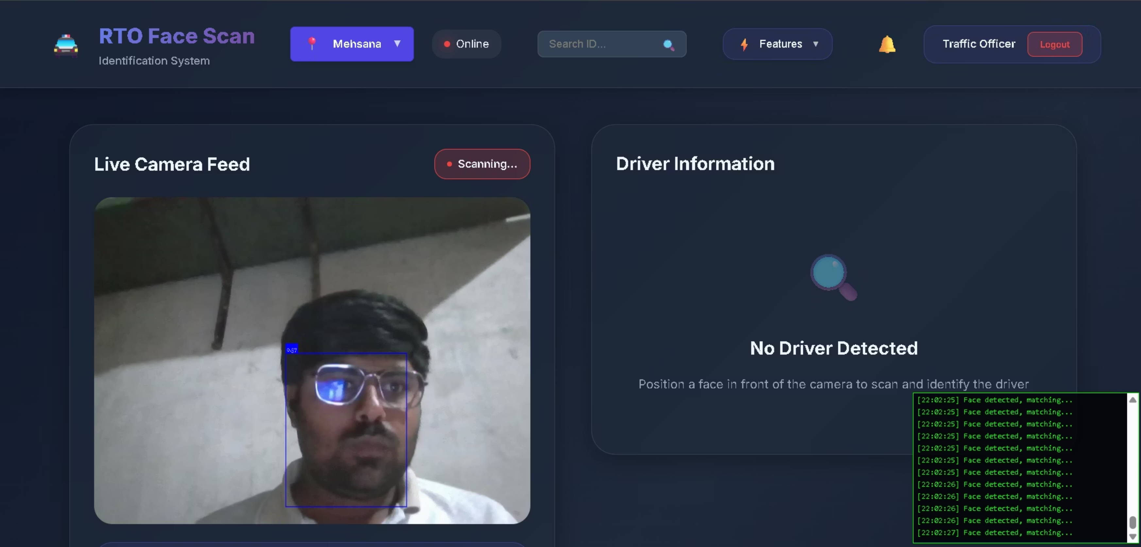
Application Interface
Main Dashboard

Slide 7

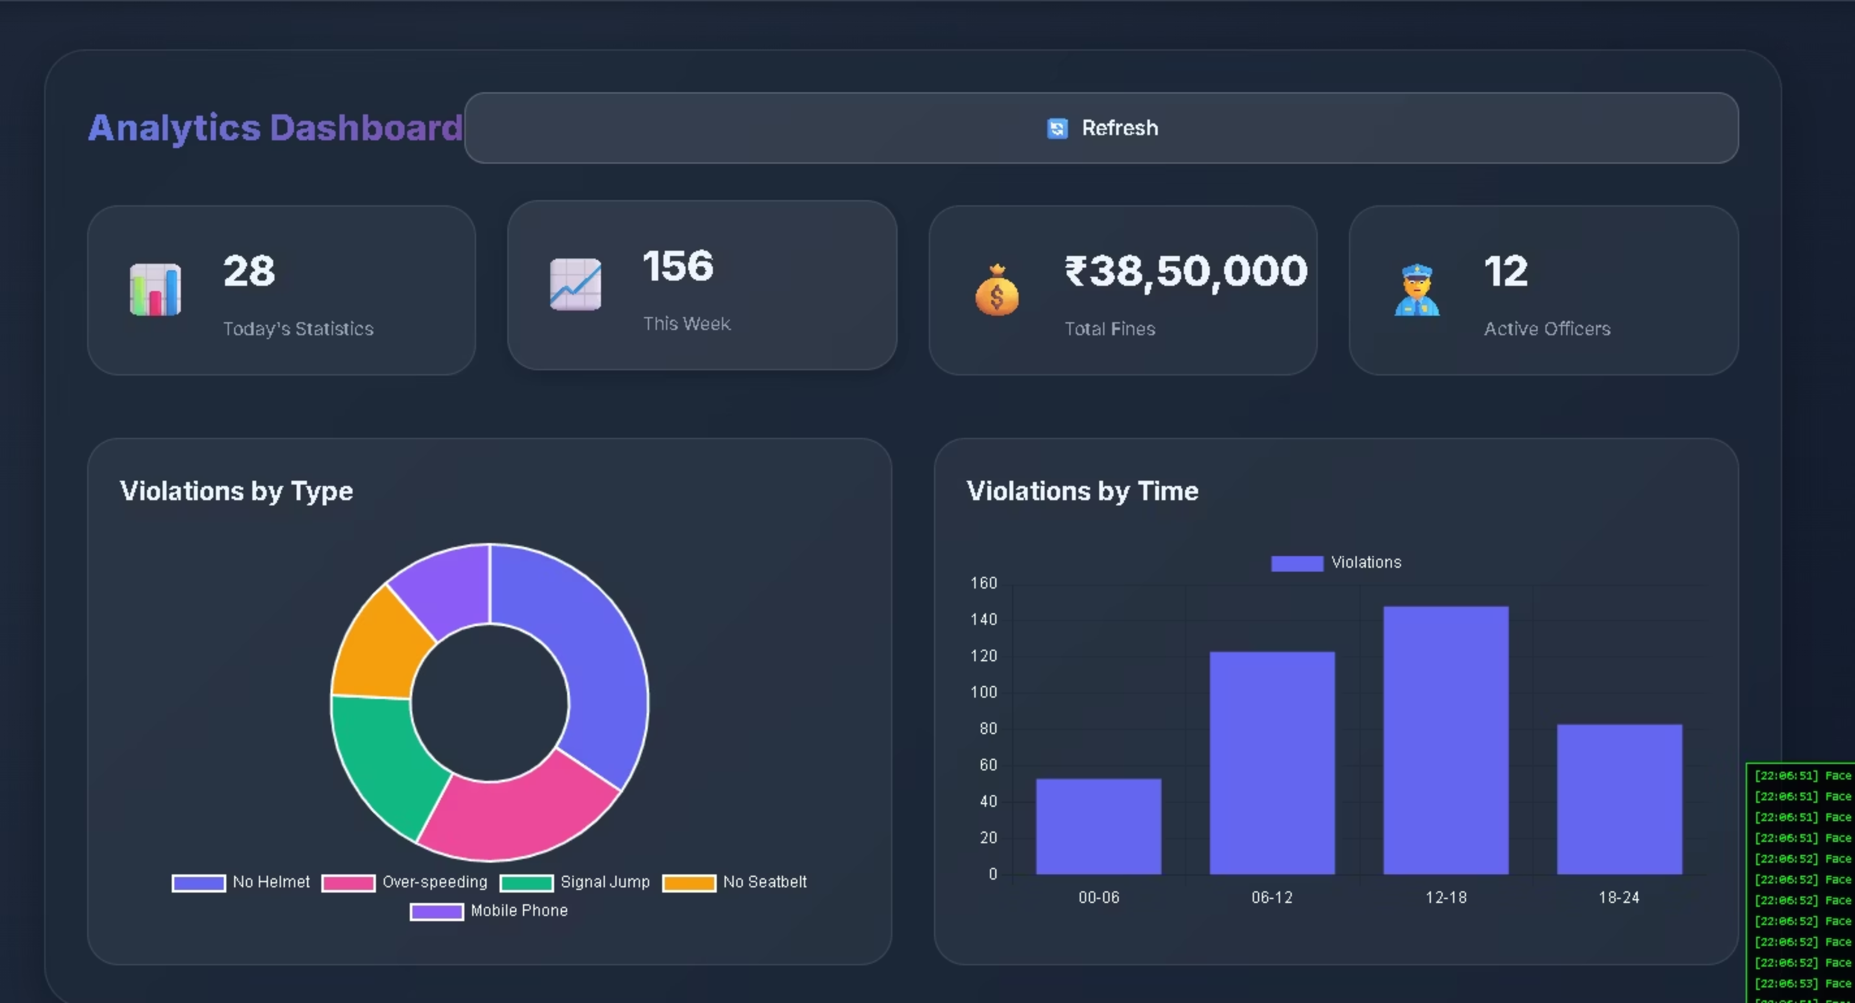
Application Interface
Analytics Dashboard

Slide 8




Technical Architecture
User Interface Layer
Application Logic Layer
Data Layer
Camera Feed
Face Recognition Engine (TinyFaceDetector + SSD)
Driver DB (JSON/SQL)
E-Challan Form
Violation & Fine Rules List
Analytics UI
Violation Logic
Local Storage (Offline)
Location Services
Cloud Sync (Online)
Payment API
A modular, layered architecture ensuring scalability and maintenance.

Slide 9

Technology Stack
Frontend
Libraries & Tools
HTML5 / CSS3: Modern semantic web
face-api.js: Vision AI
JavaScript (ES6+): Core logic
Chart.js: Analytics
Glassmorphism UI: Modern aesthetic
Leaflet.js: Maps
Node.js: Backend (Prototyped)

Slide 10


Feature 1: Face Recognition
99% Accuracy Target
Detection
Analysis
Matching
Algorithm
Threshold
Euclidean Distance Matching
0.6 (Strict matching)
Performance
Privacy
Detects in ~100ms
Stores mathematical descriptors, not raw images

Slide 11

Feature 2: Smart E-Challan
Compliance
Functionality
Compliant with Motor Vehicles (Amendment) Act, 2019
Auto-calculates total fines and generates print-ready receipts.
Violation
Fine (₹)
Category
No Helmet
₹1,000
General
Signal Jumping
₹1,000
General
Mobile Use
₹5,000
Dangerous
Over-speeding
₹2,000
Speed
Drunk Driving
₹10,000
Severe
No License
₹5,000
License
Overloading
₹20,000
Vehicle

Slide 12

Feature 3: Analytics Dashboard
Real-time insights for decision makers.
Violation Types
Time of Day Analysis
Heatmaps
Donut Chart
Bar Chart
Geolocation
Total Collection
Active Officers
Repeat Offender Rates

Slide 13

Additional Features
Bilingual Support
Payment Gateway
Notifications
Instant toggle between English, Hindi, and Gujarati.
Integrated UPI, Card, and Net Banking simulation.
Auto-SMS and Email alerts to offenders.
Doc Verification
Geolocation
Upload & verify License/RC instantly.
Tags exact location of every violation.

Slide 14

Officer Workflow
Login
Scan
Verify
Officer authenticates via secure login.
Point camera at driver. System beeps on match.
Driver details (Name, License, History) appear.
Action
Issue
Select violations from checklist.
Click "Generate Challan". Print & Send SMS.

Slide 15

System Specifications
Input Resolution
Model Size
416x416 pixels (Optimized for speed)
~6MB (Lightweight)
Frame Rate
Browser Support
~10-15 FPS on standard hardware
Chrome 90+, Edge, Firefox

Slide 16

Future Roadmap
Phase 2
Phase 3
Integration with National VAHAN/SARATHI Database.
Dedicated Mobile App (Android/iOS).
Phase 4
Phase 5
Automated Number Plate Recognition (ANPR) integration.
Predictive AI to identify accident hotspots.

Slide 17

Thank You
RTO Face Scan Project
Transforming Traffic Enforcement with AI

